Slide 1
SD Organization Structure

Slide 2
Organization Structure
Purpose
Use
Challenges
Definition of Organizational Units
Client
Company Code
Sales Organization
Distribution Channel
Division
Sales Office
Sales Group
Plant
Storage Location
Shipping Point
Lesson Objectives

Slide 3
Assignment of Organizational Units
Configuration
Define Sales Organization
Assign Sales Organization to Company Code
Sales Organization – Uses
Define Distributional Channel
Assign Distribution channel to Sales Organization
Define Division
Assign Division to Sales Organization
Set-up Sales Area
Sales Organization & Master Data
Define Sales Office
Assign Sales Office to Sales Area
Sales Group
Assign Sales Group to Sales Office
Lesson Objectives

Slide 4
Assign Sales Organization and Distributional Channel to Plant
Shipping Point
Assign Shipping Point to Plant
Attributes & Application
Transaction Codes
Tips and Tricks
Additional Information
Lesson Objectives

Slide 5
Enterprise Structure

Slide 6


Organization…?
An organized group of people with a particular purpose, such as a business or government department
The word itself is derived from the Greek word
organon meaning tool

Slide 7







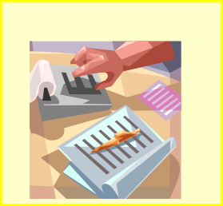





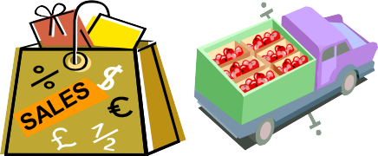

Organization Structure
FINANCE
PURCHASE
INVENTORY
Organization Structure
PLANNING & PRODUCTION
SALES & DISTRIBUTION
An organizational structure depicts the structure of an organization in terms of relationships among personnel or departments
An organizational chart also represents lines of authority and responsibility
An organizational chart indicates the formal structure of a business or company

Slide 8

Use
Organization is a Group of people with specific responsibilities acting together for achieving specific purpose determined by the organization
Any organization needs proper co-ordination within all its departments
Link between departments is maintained in
form of a hierarchy
Organizational Structure facilitates proper flow of information, division of responsibilities & effective reporting
A logical hierarchy is called as an Organizational Structure

Slide 9
Challenges
Large business houses need specialized work force to focus on specific areas of business. Different units within an Organization operate in different environments and hence develop their own specialized knowledge base, procedures, tools & techniques and policies
It is a challenge to create a hierarchical structure that will cater to the needs of individual units yet integrate the effort to meet the common objectives
In any business it becomes increasingly difficult to ensure proper coordination, proper exchange of information, ability to react quickly and collate information required to form a big picture if the Org structure is too complex or too layered
A balanced and simple structure can optimize this need for autonomy for various units and coordinate the efforts effectively

Slide 10

Definition of Organizational units
Organizational Units defined in SAP SD are:
Sales Organization
Distributional Channel
Division
Sales Office
Sales Group
Other important Organizational Units that are necessary are Client, Company Code, Plant, Storage Location and Shipping Point

Slide 11

Client
Highest level of Organizational unit, with its own data, master records and set of tables.
Examples for Client specific data:
User Master data: Authorization and User Groups
Application data: Business transaction data and Material Master data
From the business prospective a client forms a corporate group

Slide 12
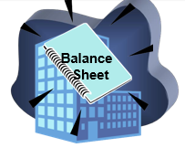
Company Code
Represents an independent legal Accounting entity
Example: Company with a corporate group
Balance sheet & Profit & Loss statements required by law, can be created at the company code level. Therefore, a company code is the minimum structure necessary in R/3 FI
In an international business, operations are often scattered across many countries. Since most government & tax authorities require the registration of a legal entity for every company, a separate Company code is usually established per country

Slide 13


Sales Organization
The sales organization is an organizational unit within logistics, that structures the company according to its sales requirements. It is responsible for the sale and distribution of goods and services. It represents the selling unit as a legal entity. It is responsible for product guarantees and other rights to recourse

Slide 14
Distributional Channel
Represents the channel through which saleable materials or services reach customers
Within a sales organization a customer can be supplied through several distribution channels. In addition, the material master data relevant for sales, such as prices, minimum order quantity, minimum quantity to be delivered and delivering plant, can differ for each sales organization and distribution channel
Typical distribution channels include wholesale, retail and direct sales
A single distribution channel can be assigned to one or more sales organizations

Slide 15


Division
Division is a collection of Product groups. A material belongs to exactly one division only
You can define sales offices for a division
You can define for each sales document type that all items of a sales document must belong to the same division

Slide 16

Sales Office
Defines Geographical aspects of the organization in business development and sales
Establishes contact between the firm and the regional market

Slide 17

Sales Group
The staff of a sales office may be subdivided into sales groups
Responsible for all items in a sales document however items in a delivery or a billing document can belong to different sales groups
Sales group is a selection criterion for lists of sales documents
For each sales group, you can determine the printer for output differently on the basis of the sales documents

Slide 18

Plant
An organizational unit where important business functions like Delivery Processing, Production, Procurement, Inventory Management, are carried out
Plant plays an important role in following areas:
Sales Org/Gen Plant Data view is maintained at Plant Level
Materials can be valuated at Plant Level
A Factory Calendar is controlled at Plant Level
User level authorization can be controlled at Plant Level

Slide 19

Storage Location
An organizational unit that allows the differentiation of material stocks within a plant
Stock of a material always belongs to a Storage location. Thus at least one storage location is necessary for in-bound & out-bound delivery processing

Slide 20
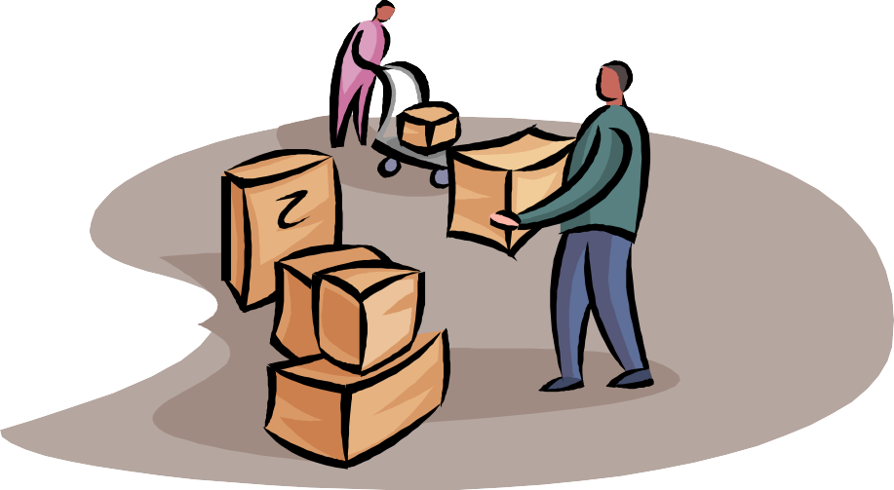
Shipping Point
Part of the company responsible for the type of shipping, the necessary shipping materials and the means of transport
For example, a Shipping Point can be a company’s mail depot or plant rail station

Slide 21


Assignment of Organizational units
In SAP R/3 you represent Organizational Structure as legal and logical representing the hierarchy of your company by assigning the organizational units which represent individual departments
This assignment forms the base for all Sales activities in SAP, with out which no transaction can be executed
Also, it is generally necessary to interact with other
organizational units such as Plants or Shipping points

Slide 22

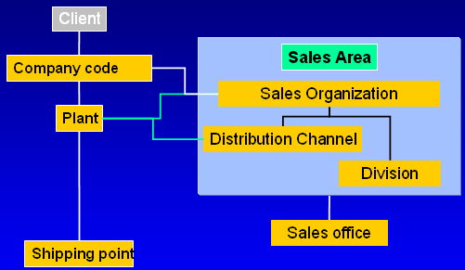
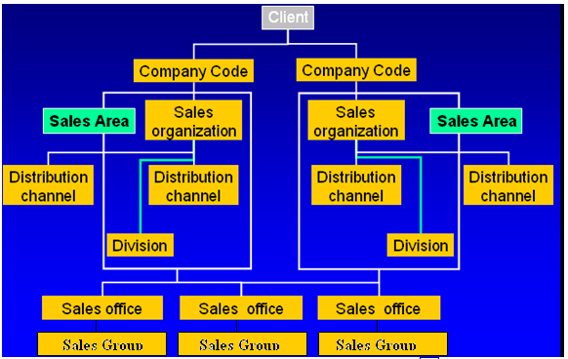
Assignment of Organizational units`
Organizational Units are logically assigned to create a hierarchical structure

Slide 23
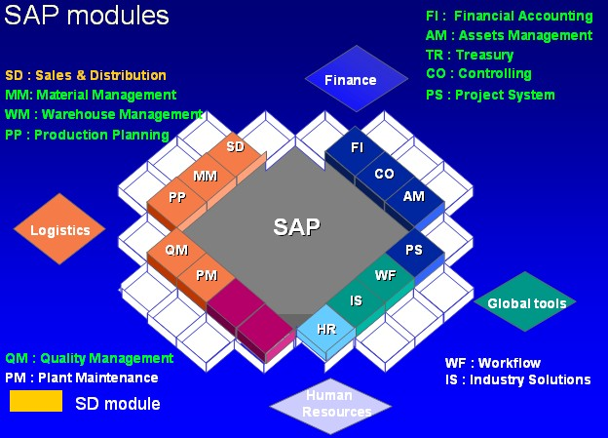
Environment
The current scenario explains about organizational structure in R/3 system version ECC 5.0
Some of the functionalities explained are version dependent. For example, upto version 4.x it was possible to derive Credit Control Area from the company code only, which is now possible from Sales Area

Slide 24
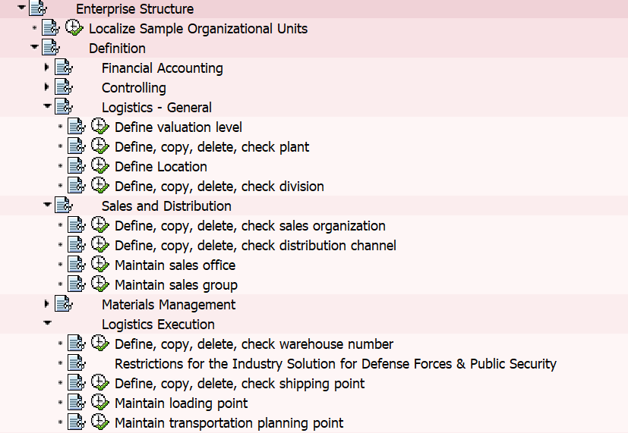
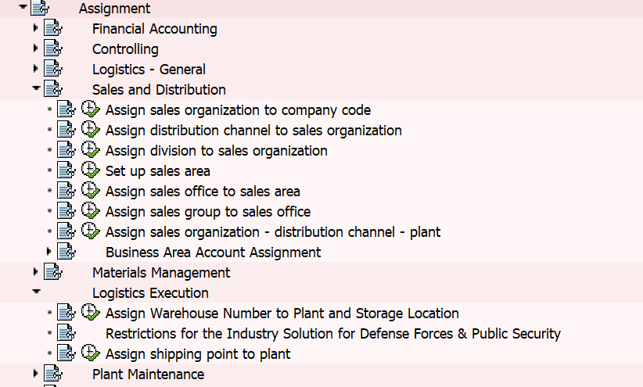
Configuration
Defining
Assigning
Menu Path for Configuration:
Display IMG→ Enterprise Structure→ Definition Display IMG→ Enterprise Structure→ Assignment

Slide 25
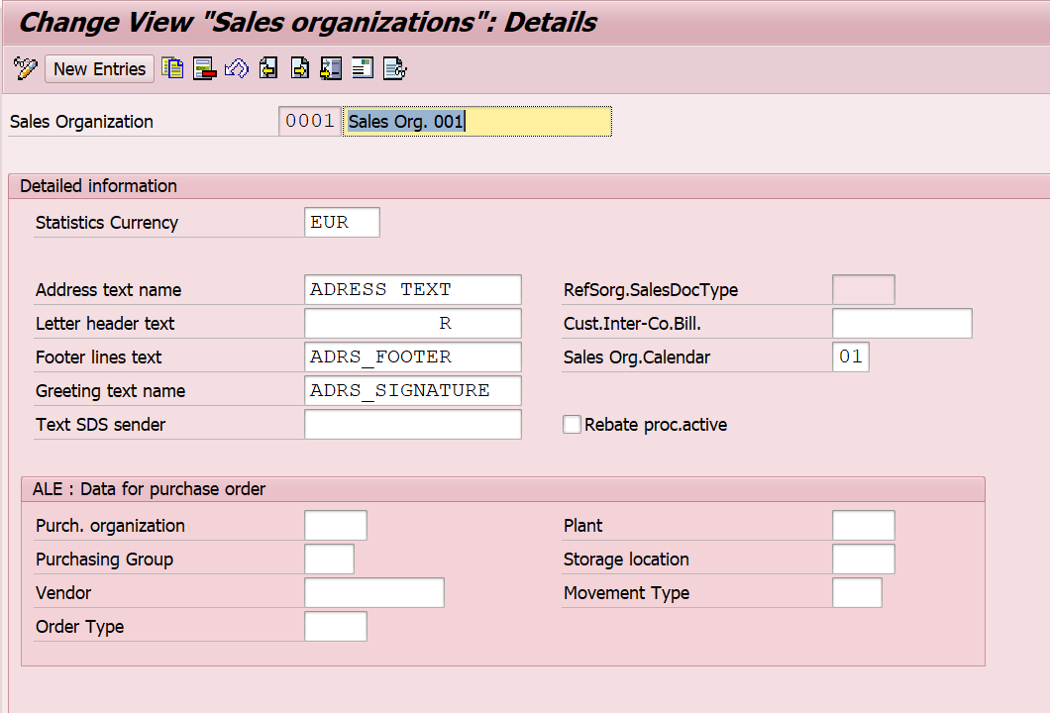
Define Sales Organization
Define the Currency for the sales organization.
Assign Customer for Inter-company billing
Define the working days for the sales organization.
Select the check box if you need Rebate processing to be active.
Sales Org’ code (can be alpha numeric)
Address details

Slide 26
Define Sales Organization
Display IMG→ Enterprise Structure→ Definition→Sales & Distribution

Slide 27







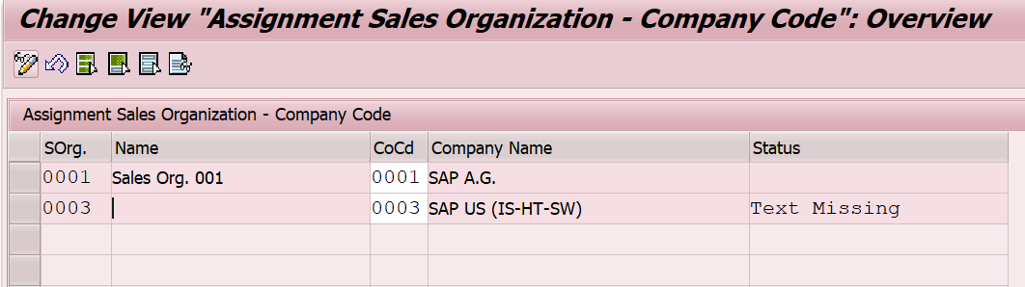
Assign Sales Organization to Company Code
Company Code
Sales Org
Sales
Org 1
Sales Org 2
Comp Code1
Comp Code2
Display IMG→ Enterprise Structure→ Assignment →Sales and Distribution
A Sales Organization is assigned to one and only one Company Code

Slide 28
Sales Organization - Uses
A Sales Organization is the highest level of organizational Unit in SD
A new Sales Organization should always be created by copying an existing one
Sales Organization has address, calendar, statistical currency and controls Rebate Processing and Inter Company Sales
Assigning Sales Org to Company Code establishes the link between SD and FI
Reports can be generated at Sales Organization Level

Slide 29
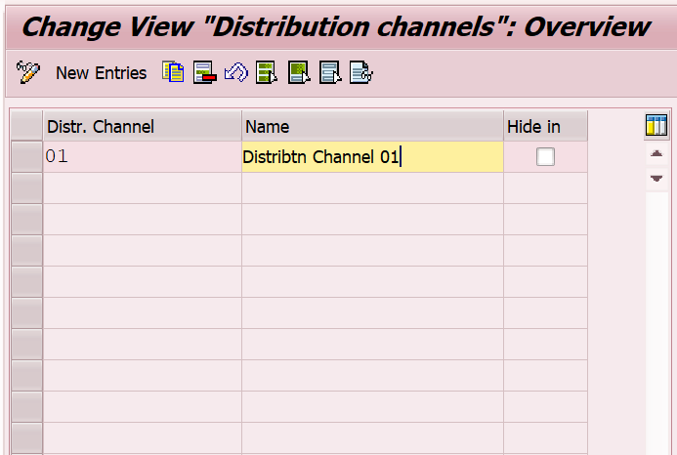
Define Distributional Channel
Alpha numeric codes
Display IMG→ Enterprise Structure→ Definition→Sales and Distribution
A Distribution Channel is just a text value and has no controls behind

Slide 30
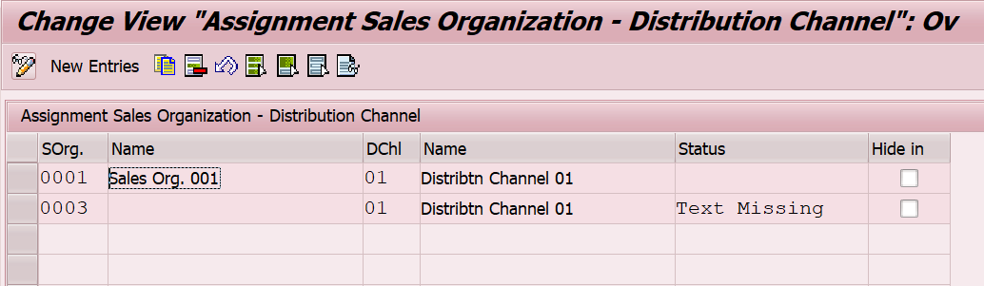






Assign Distribution channel to Sales Organization
Sales Org
Sales Org
Sales Org
A Distribution Channel can be assigned to one or many Sales Organizations and visa versa
Display IMG→ Enterprise Structure→ Assignment →Sales and Distribution
DC1
DC2
DC1

Slide 31
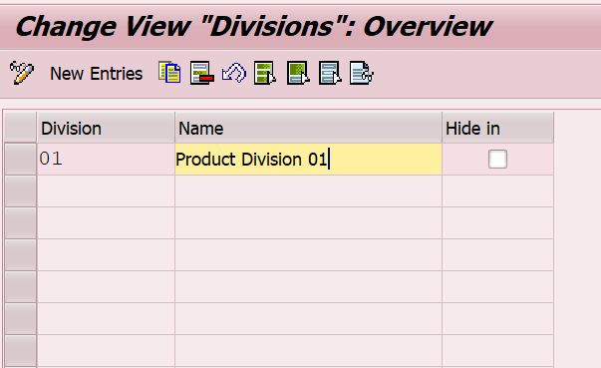
Define Division
Alpha numeric codes
Display IMG→ Enterprise Structure→ Definition→ Logistics -General
A Division is just a text value and has no controls behind

Slide 32
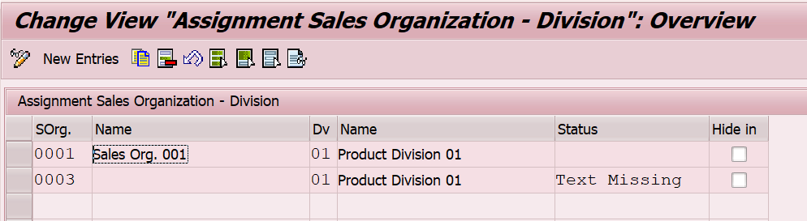







Assign Division to Sales Organization
A Division can be assigned to one or many Sales Organizations and visa versa
Sales Org
Sales Org
Sales
Org
Division
Div 1
Div 2
Display IMG→ Enterprise Structure→ Assignment →Sales and Distribution

Slide 33
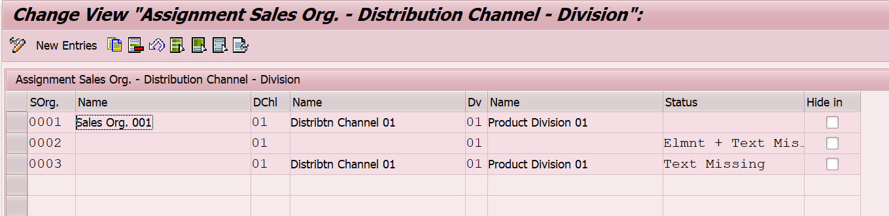
Set-up Sales Area
Sales Area is the set-up that combines sales organisation, distributional channel and division
By setting up Sales Area:
You can define materials belonging to which divisions can be sold thorough specific Distribution Channels such as Whole-sale or Retail
You can control specific transactions based on allowed document types

Slide 34
Set-up Sales Area
Display IMG→ Enterprise Structure→ Assignment →Sales and Distribution

Slide 35

Sales Organization & Master Data
Sales Organization Controls Master Data Creation, where Common Distribution Channel and Common Division is combined with respective Sales Organization to reduce master data creation work
In such a case Condition Master records, Customer Master Records and Material Master records are created only once for one sales area and need not be extended to each and every sales area

Slide 36
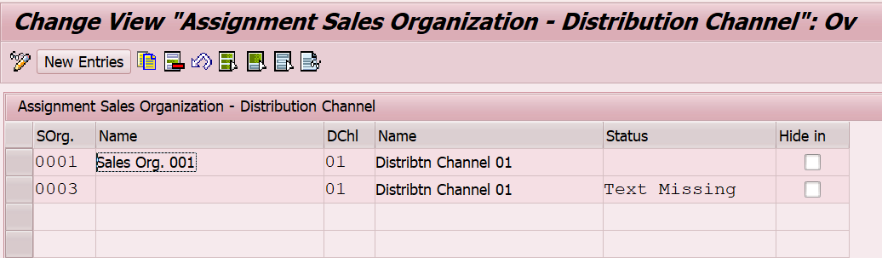
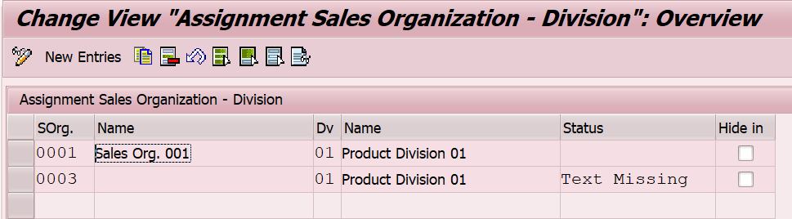
Sales Organization & Master Data
Display IMG→ Sales and Distribution → Master Data

Slide 37
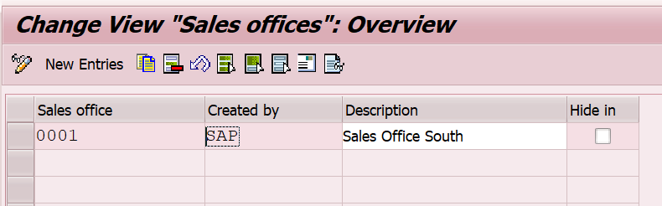
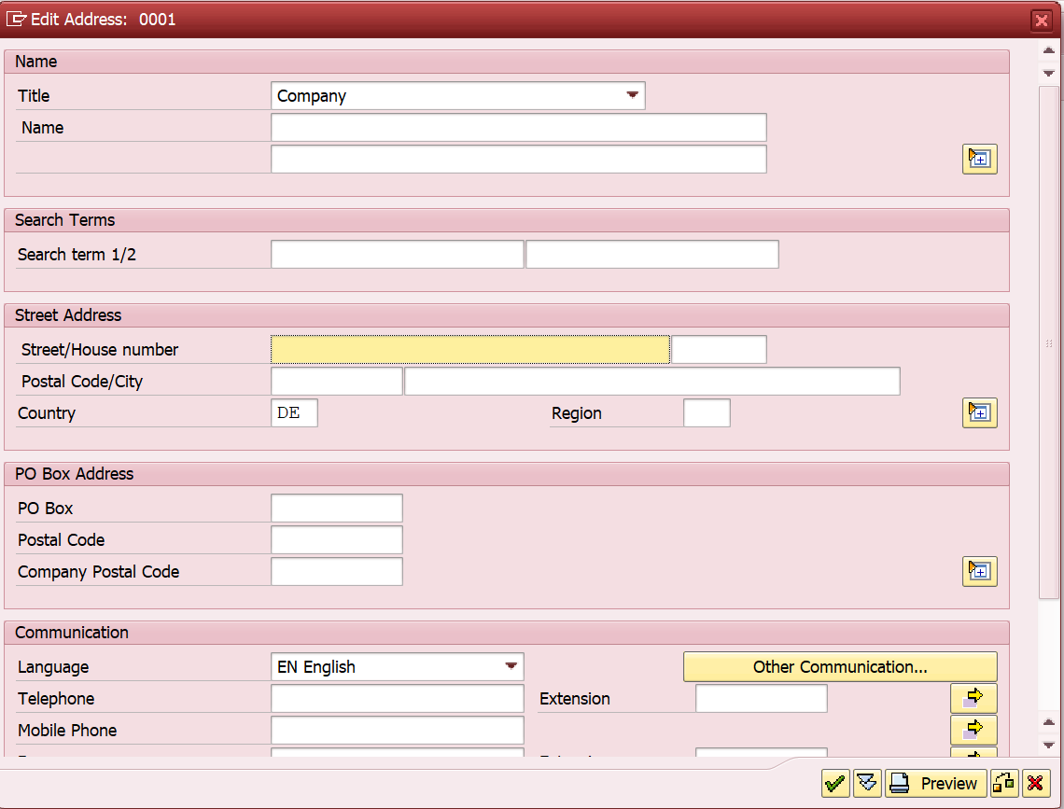
Define Sales Office
Click to maintain address
Display IMG→ Enterprise Structure→ Definition →Sales and Distribution
A Sales Office is just a text value and has no controls behind

Slide 38
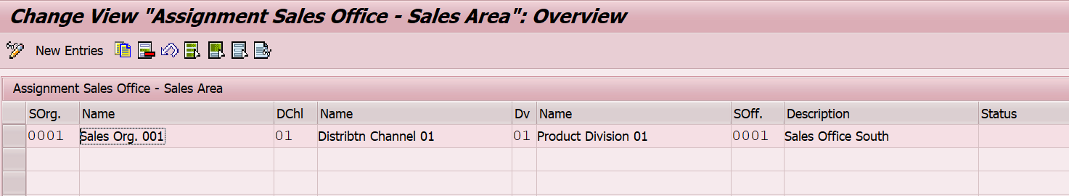
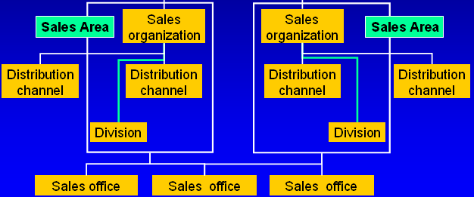
Assign Sales Office to Sales Area
Display IMG→ Enterprise Structure→ Assignment →Sales and Distribution

Slide 39
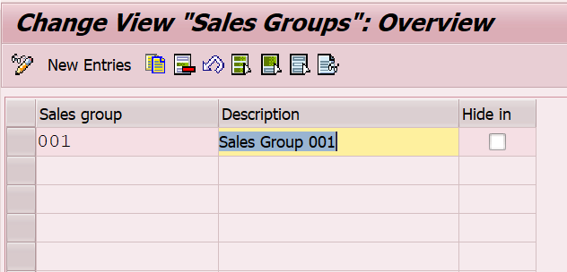
Sales Group
Enter a 3 digit alpha- numeric key
Display IMG → Enterprise structure → Definition → Sales & Distribution → Maintain Sales Groups
A Sales Group is just a text value and has no controls behind

Slide 40
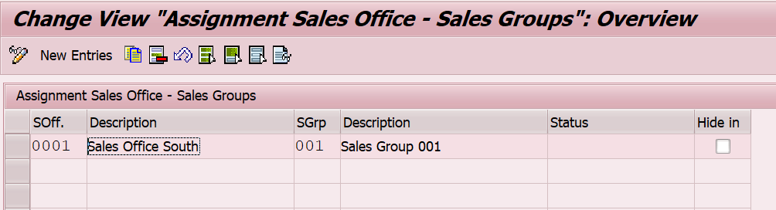


Assign Sales Group to Sales Office
Sales Group
Sales Grp 1
Sales Grp 2
More than one sales group can be assigned to one sales office and one sales group can belong to several sales offices
Sales
Office
Sales Grp 1
Sales
Grp 2
Display IMG → Enterprise structure → Assignment → Sales & Distribution →Assign Sales Group to Sales Office

Slide 41
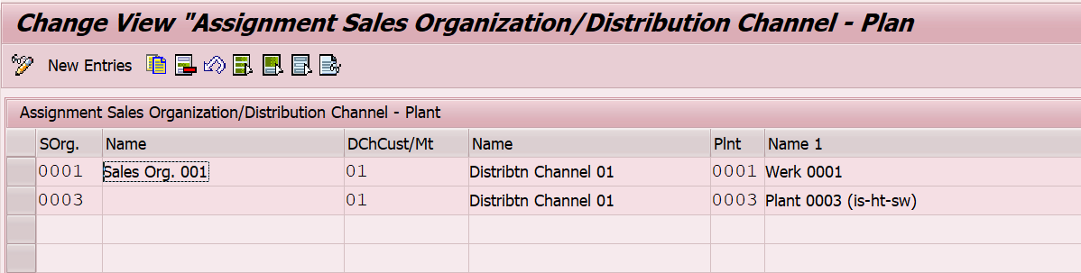





Assign Sales Organization and Distributional Channel to Plant
More than one Plant can be assigned to combination of Sales Organization and Distributional Channel and vice-versa
When plant of one company code is assigned to the combination of Sales Organization and Distributional Channel belonging to another company code the scenario results into Inter-company Sales
Sales Org
+
Dist Chn
Sales Org
+
Dist Chn
Sales Org
+
Dist Chn
Plant
Plant 1
Plant 2
Display IMG → Enterprise structure → Assignment → Sales & Distribution →Assign Sales Group to Sales Office

Slide 42
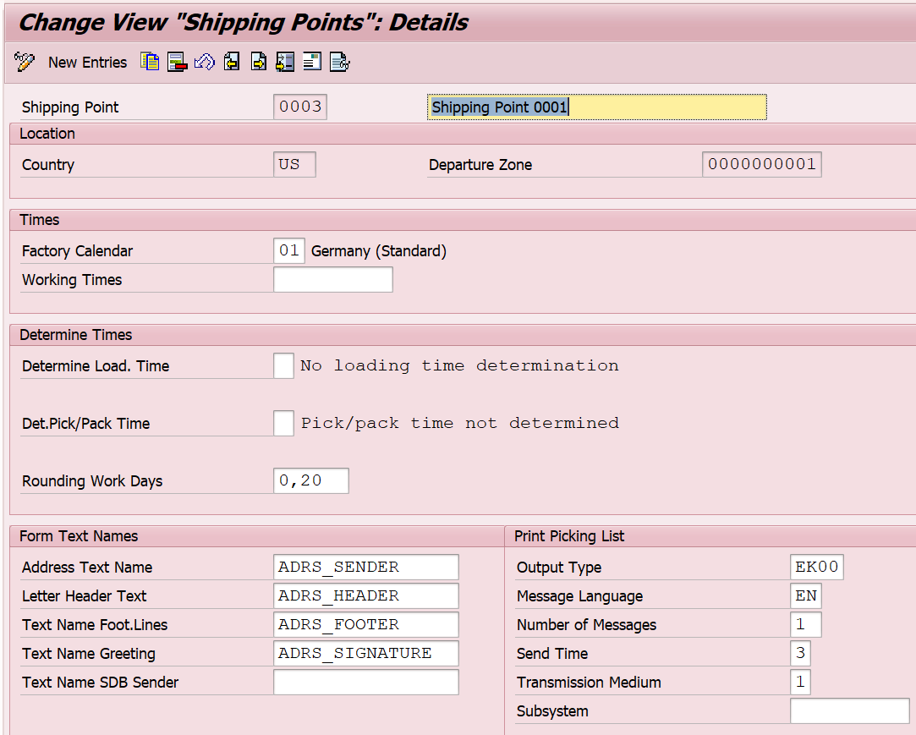
Shipping Point
A Shipping point has its own working days & timings
Lead time maintained is used for delivery proposal
Display IMG → Enterprise structure → Definition → Logistics Execution → Define Shipping Point

Slide 43
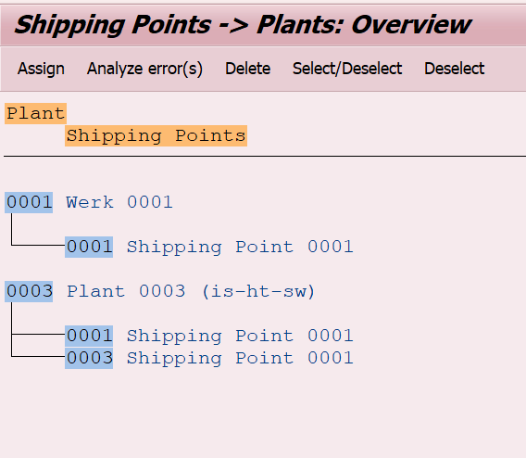
Assign Shipping Point to Plant
Shipping
Point
Ship Pt 1
Ship
Pt 2
Plant 1
Plant 2
Plant
More than one Shipping Point can be assigned to a Plant and vice versa
Though it is possible to one Assign Shipping to several Plants, generally it is avoided. Creating & assigning a unique Shipping Point to each plant helps in Authorization Control & differentiating delivery documents belonging to a unit.

Slide 44
Assign Shipping Point to Plant
Display IMG → Enterprise structure → Assignment → Logistics Execution → Assign Shipping Point to Plant

Slide 45
Attributes & Application
Org Units | Attributes | Application
Sales Organization | Name and Address Language and Currency Factory Calendar | Rebate Processing Intercompany Sales Account Determination User Level Authorization
Distribution Channel | Name | Controls Material Master Sales View ( along with Sales Org) Other master data such as Conditions User Level Authorization
Division | Name | Master Data creation such as Customer & Conditions A Material belongs to exactly one Division
Sales Area | Assignment Only | Pricing Free Goods Output Determination Partner Determination Document Types

Slide 46
Attributes & Application
Org Units | Attributes | Application
Company Code | Name and Address Language and Currency | Balance Sheet & Profit & Loss statement. Transfers financial Information to Controlling Revenue Accounting Credit Policies User Level Authorization
Plant | Name and Address Language and Currency Factory Calendar | Taxation Inter-company Sales Master data maintenance User Level Authorization
Storage Location | Name and Address | Physical Inventory Delivery Processing Reporting
Shipping Point | Name and Address Factory Calendar Working hours Lead Time | Delivery Processing Transportation

Slide 47
Transaction Codes
OVX5 | Define Sales Organization
OVXI | Define Distributional Channel
OVXB | Define Division
OVX1 | Define Sales Office
OVX4 | Define Sales Group
OVX3 | Assign Sales Organization to Company Code
OVXK | Assign Distribution Channel to Sales Organization
OVXA | Assign division to sales organization
OVXG | Set up sales area
OVXM | Assign sales office to sales area
OVXJ | Assign sales group to sales office
OVX6 | Assign sales organization - distribution channel - plant

Slide 48
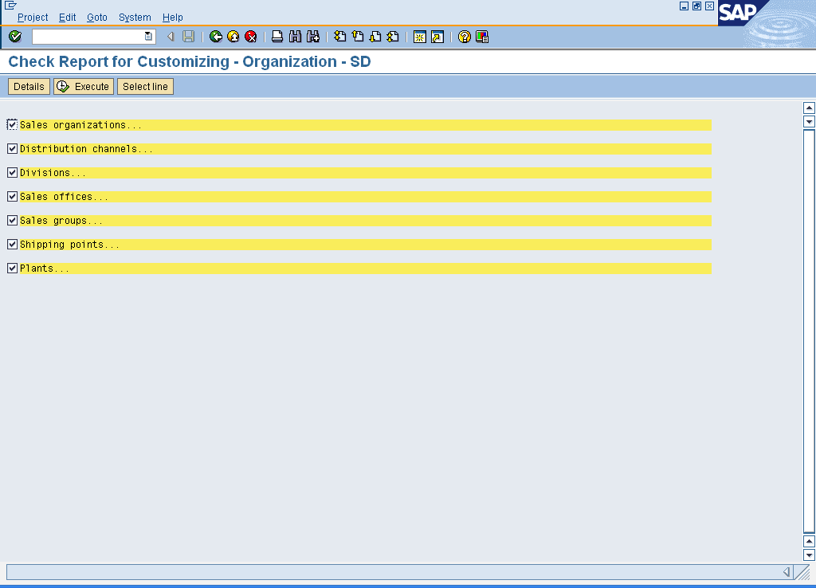
Tips and Tricks
You can check the Assignment of Org Units in Sales and Distribution from IMG Menu Path:
Enterprise Structure → Consistency Check → Check Enterprise Structure for Sales & Distribution
For example, you can check whether the addresses were maintained for all sales organizations, whether the allocation to a company code was made and a sales area created

Slide 49
Additional Information
The definition of organization units is a fundamental step in your project. It is a critical factor in how the project will be structured. You should not use more organization units than necessary. Once you have decided on an organizational structure it is not easy to change it
In order to simplify master record and document entry, the organizational units can be stored as user parameters in the user master record. It is not necessary to specify the organizational units since the values are proposed automatically. The following are examples of IDs defined for user parameters:
SPA – Division
VKO-Sales Organization
VTW - Distribution channel
WRK – Plant

